Slide 1
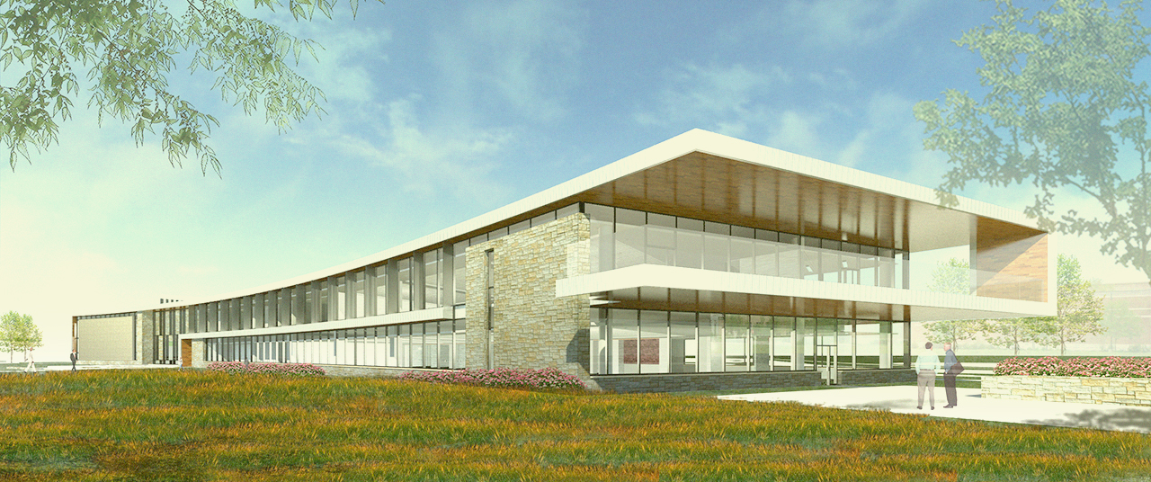
Frederick College of Cardiology Arlington Heights, IL
Schematic Design Presentation
by Rob Currie

Slide 2
Building Usage
Education facility for Physicians and Physicians in training
Auditorium for conferences and demonstrations
Office space for administration employees
Similar to the IALD of Cardiologists

Slide 3
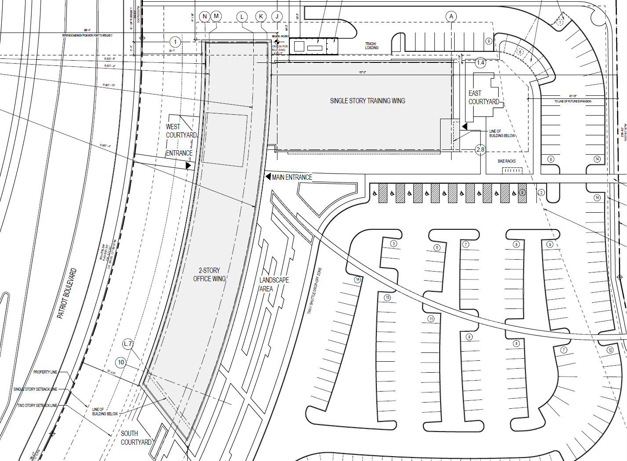
Auditorium
48,000 sq. ft.

Slide 4
The Manikin

Slide 5
The Human Body

Slide 6
Deconstructed
Unfamiliar Out of Context

Slide 7
Deconstructed
Unfamiliar Out of Context

Slide 8
Deconstructed
Unfamiliar Out of Context

Slide 9
Studying the Unfamiliar
Lighting in Unexpected Ways

Slide 10
Focus Spaces
Auditorium
Open Office
Psychological Impression
Main Lobby
3 Schematic Design Concepts
Façade

Slide 11
Auditorium> Floor Plan
Auditorium

Slide 12
Auditorium> Floor Plan

Slide 13
Auditorium> Design Criteria + Considerations
SETTING | Illuminance Horiz. | Height | Illuminance vert. | Height | Uniformity
Lecture Setting A/V with notes | 50 lux | @ 2’ a.f.f. | 15lux | @ 4’ a.f.f. | 2:1 Avg:Min
Lecture Setting A/V without notes | 10 lux | @ floor | 6lux | @ 4’ a.f.f. | 2:1 Avg:Min
Lecture Setting no A/V | 100 lux | @ 2’ a.f.f. | 40lux | @ 4’ a.f.f. | 2:1 Avg:Min
Demonstration | 1000 lux | @ 3’ a.f.f. | 500lux | @ 4’ 6” a.f.f. | 3:1 Avg:Min
Concentrated light levels specifically for lighting surgical demonstrations in the front of the auditorium will be necessary. Spot lighting should create high illuminance on the demonstration area while not causing additional glare on the projector screen.
Control system must be able to control the auditorium in full mode and in separate sections.
- Lighting controls must be useful for many different activities in the space but also simple for use by educators and students. (IES The Lighting Handbook, pg. 24.3)

Slide 14
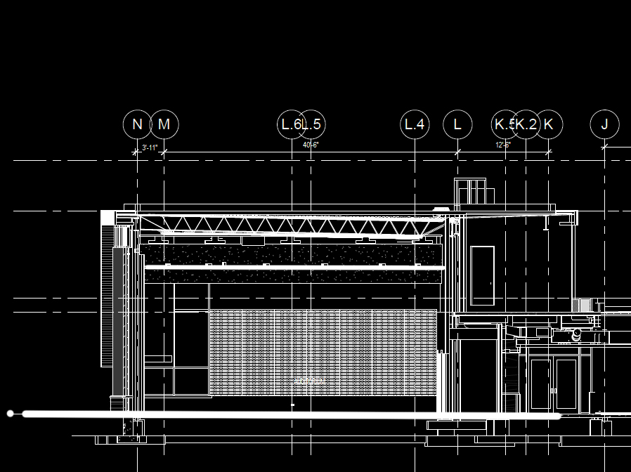
Auditorium> Schematic Design > Sketches

Slide 15
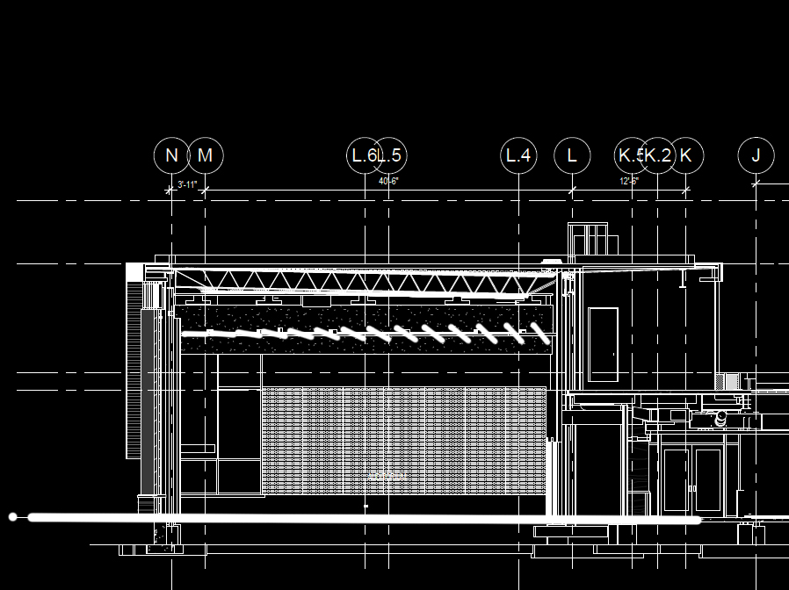
Auditorium> Schematic Design > Sketches

Slide 16
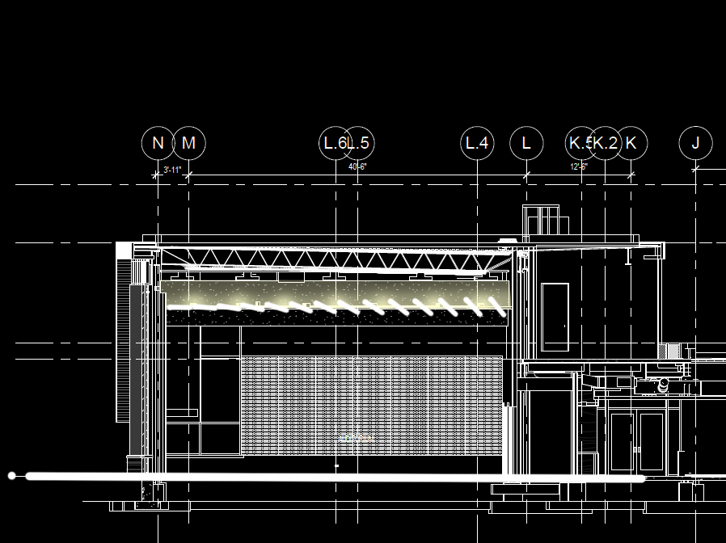
Auditorium> Schematic Design > Sketches

Slide 17
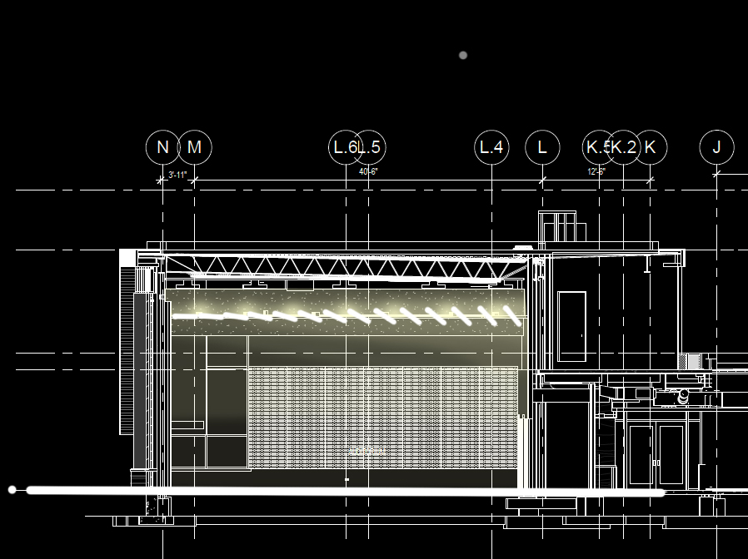
Auditorium> Schematic Design > Sketches

Slide 18
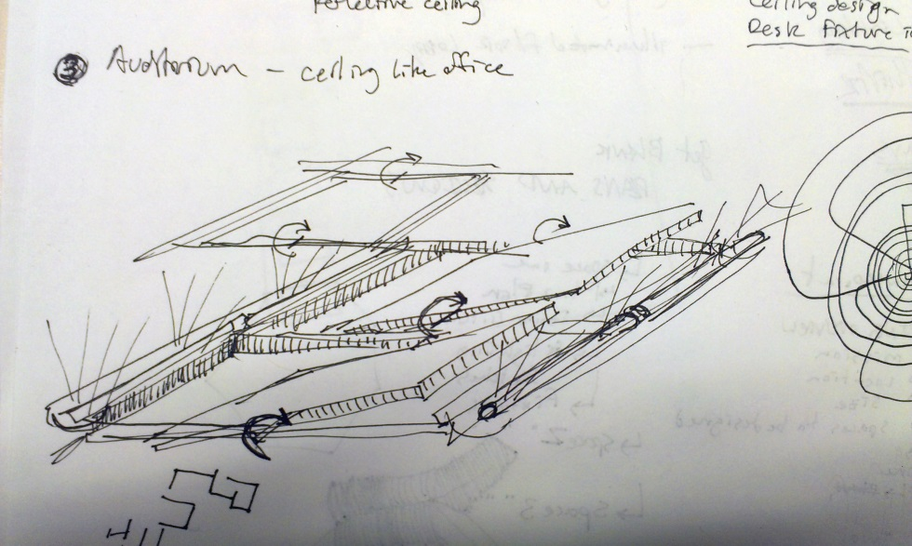
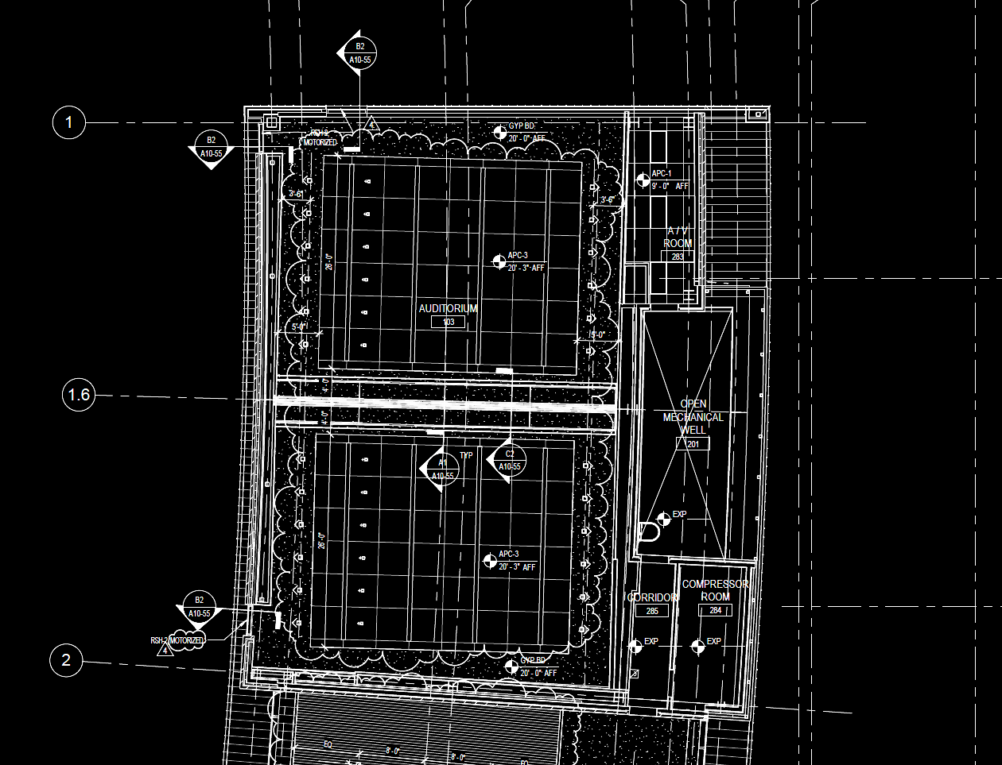
Auditorium> Schematic Design > Sketches

Slide 19
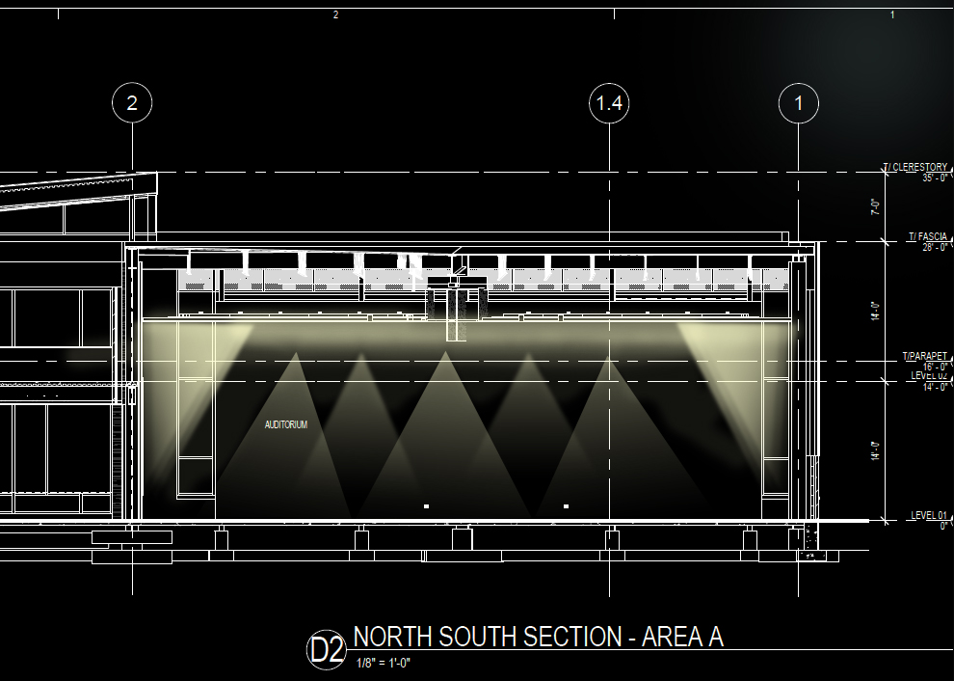
Auditorium> Psychological Impression > Spacious
Ambient lighting creates uniformity
Walls and ceiling highlighted
Deconstructed ceiling creates the illusion of a extended space beyond the actual ceiling

Slide 20
Auditorium> Schematic Design > Sketches
Deconstructed ceiling blurs the lines between regular surfaces of the space.
Illumination originates from a hidden source
Gaps in ceiling suggest that there is a larger unkown space behind the plane of the ceiling.

Slide 21
Auditorium> Schematic Design > Controls

Slide 22
Auditorium> Schematic Design > Controls
Controls system must adapt to address both auditorium spaces as one unit or two separate rooms.
“Sky Fold” wall triggers control system mode of operation.
Wall is up > Controls merge both rooms fixtures together
Wall is down > Controls separate both spaces fixtures
Bright illuminance at front of room for demonstrations must be controlled as to not wash out projector screens operating in close proximity

Slide 23
Open Office > Floor Plan
Office

Slide 24
Open Office > Design Criteria & Considerations
SETTING | Illuminance Horiz. | Height | Illuminance vert. | Height
VDT Screen and keyboard + polarity | 300lux | @ 2’ 6” a.f.f. | 150lux | @ 4’ a.f.f.
VDT Screen and keyboard - polarity | 150lux | @ 2’ 6” a.f.f. | 50lux | @ 4’ a.f.f.
Reading 12 point font | 200lux | @ 2’ 6” a.f.f. | 50lux | @ 5’ a.f.f.
Visual rest from typical tasks of reading and writing should be provided
Day lighting and views should be incorporated into a successful design
Day lighting automated shades and dimming control implemented
- Direct glare from luminaires should be avoided

Slide 25
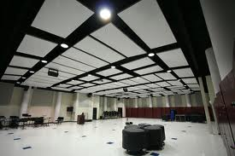
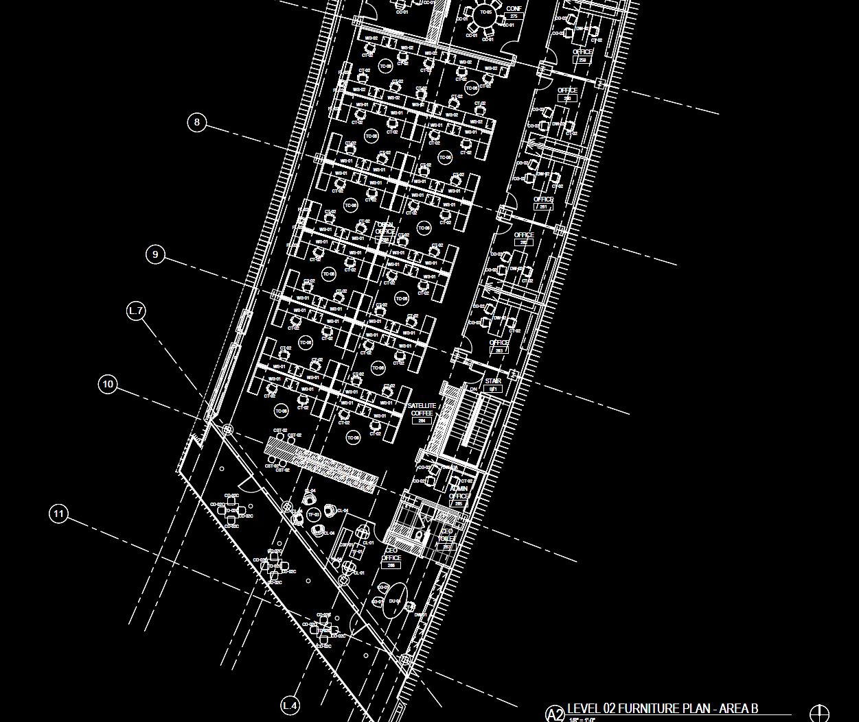
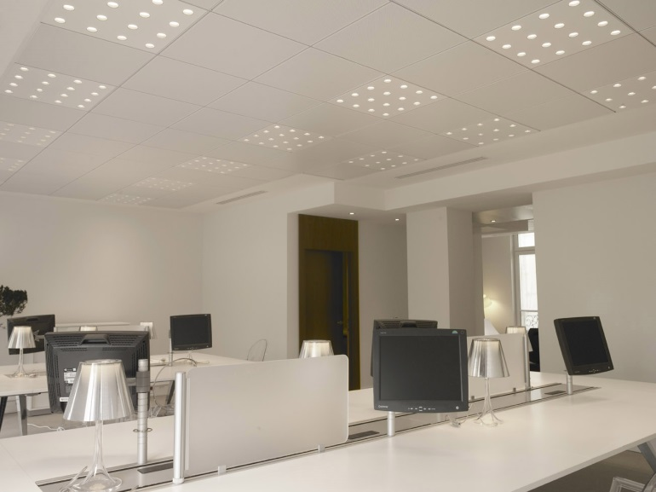
Open Office > Schematic Design
Office

Slide 26
Open Office > Schematic Design
Office

Slide 27
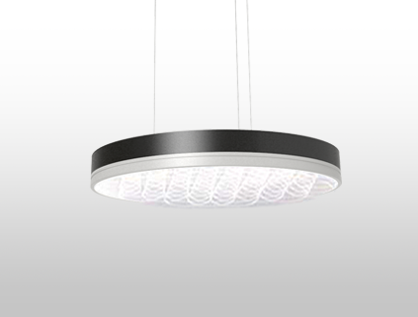
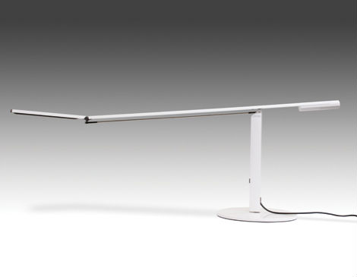
Open Office > Schematic Design
Micro-Prismatic Lens
LED Task Lighting
Office

Slide 28
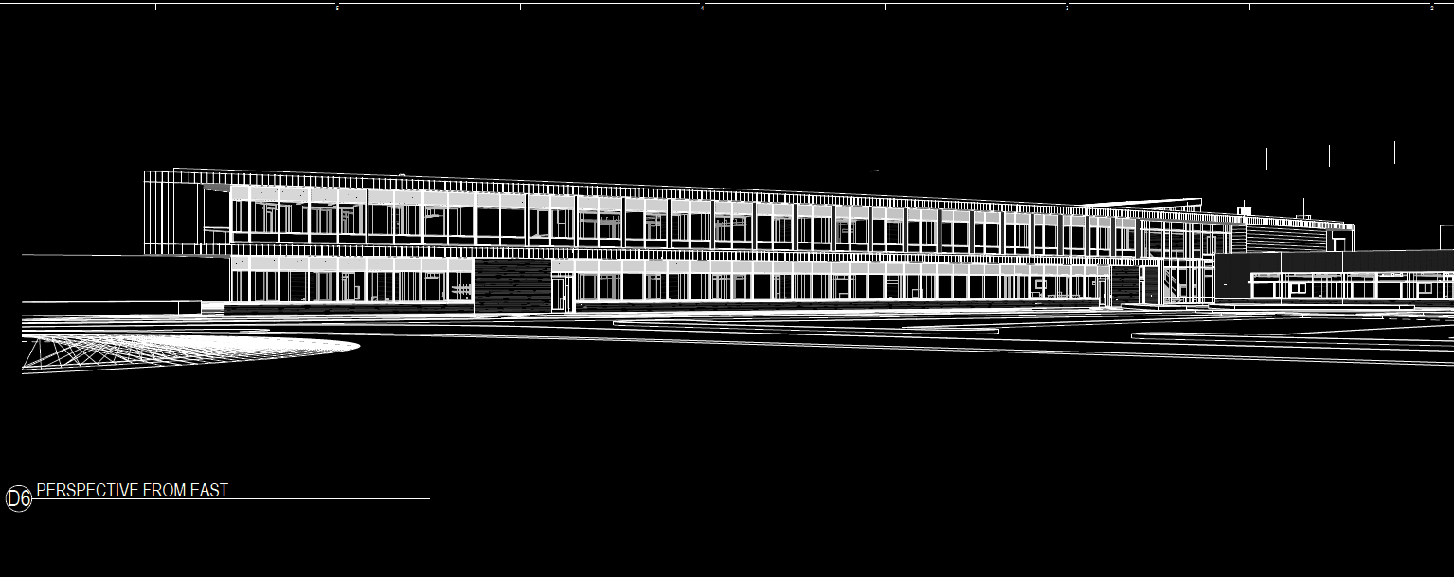
Open Office > Daylighting
Office
Full window exposure on East and West sides of the office wing

Slide 29
Main Lobby > Floor Plan
Lobby

Slide 30
Main Lobby > Floor Plan

Slide 31
Main Lobby > Design Criteria & Considerations
SETTING | Illuminance Horiz. | Height | Illuminance vert. | Height | Uniformity
Lobby @ building entrance DAY | 100lux | @ floor | 30lux | @ 5’ a.f.f. | 4:1 Avg:Min
Lobby @ building entrance NIGHT | 50lux | @ floor | 20lux | @ 5’ a.f.f. | 4:1 Avg:Min
Lobby distant from entries | 100lux | @ 2’ a.f.f. | 30lux | @ 5’ a.f.f. | 4:1 Avg:Min
Lobby desk top | 150 | @3 6” a.f.f. | N/A | N/A | 4:1 Avg:Min
Day lighting should be used as a large component of lighting the space during daytime hours.
Transitional brightness at entrances should be considered to aid adaptation.
Lobby should exemplify the character of the occupant through referencing the work of the college in the lighting design.
Wayfinidng emphasis building spaces

Slide 32
Main Lobby > Schematic Design 1

Slide 33
Main Lobby > Schematic Design 1

Slide 34
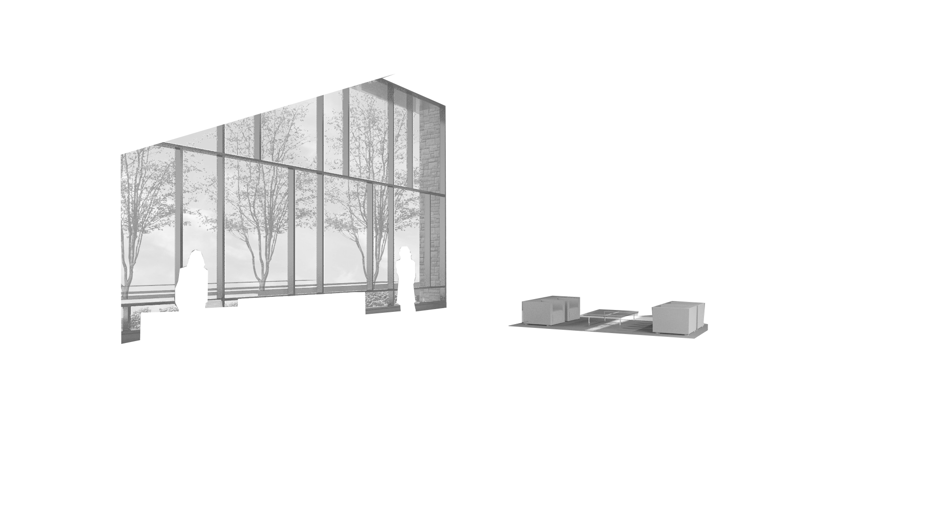
Main Lobby > Schematic Design 1

Slide 35
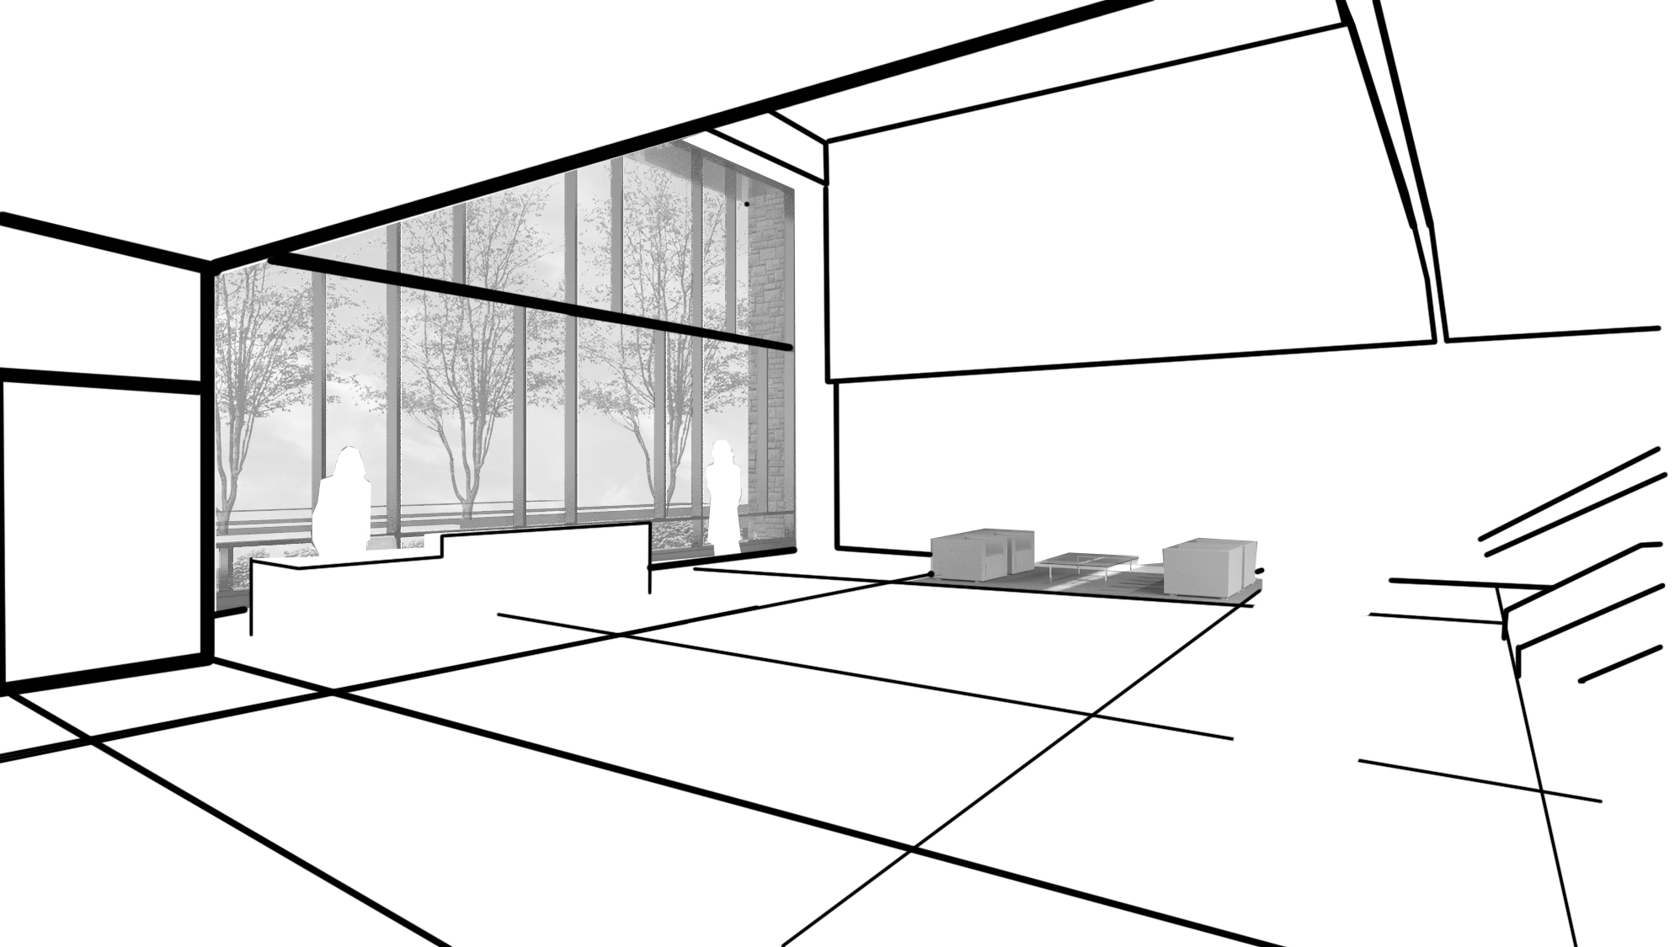
Main Lobby > Schematic Design 1

Slide 36
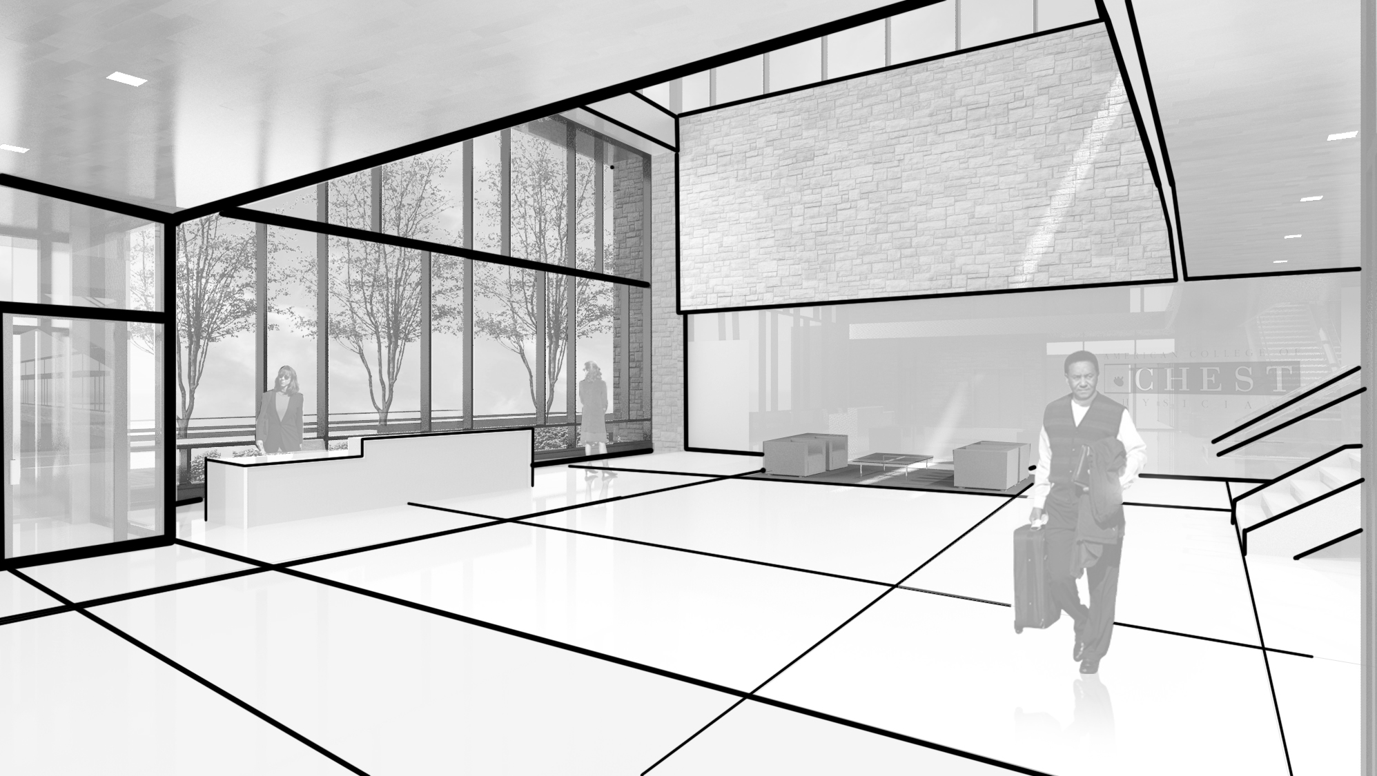
Main Lobby > Schematic Design 1

Slide 37
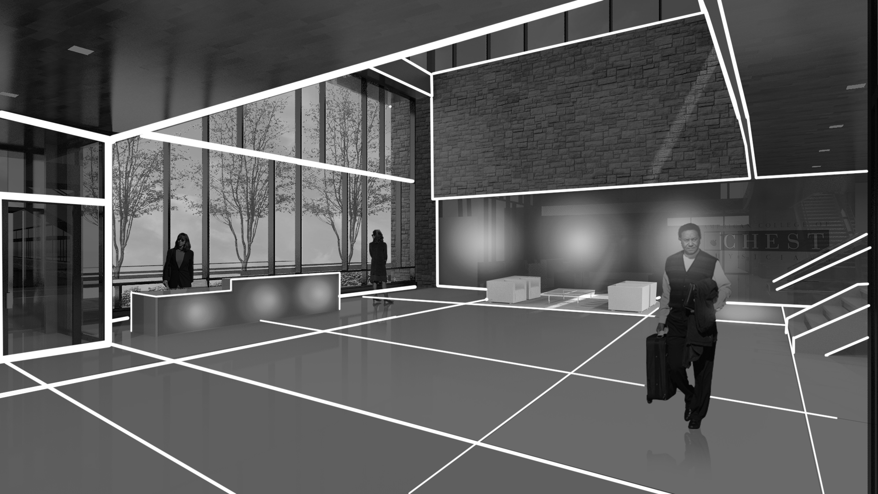
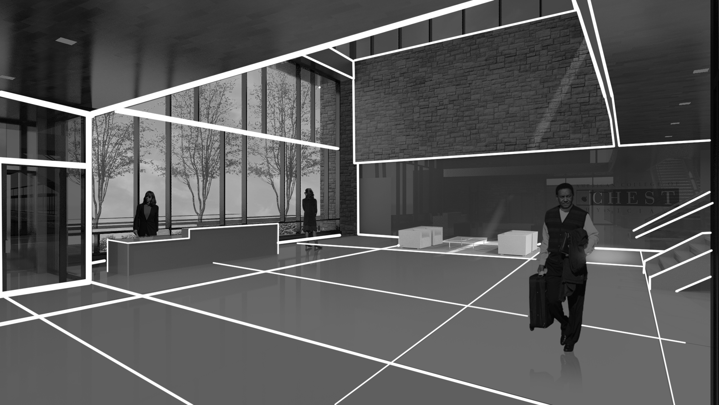
Main Lobby > Schematic Design 1

Slide 38
Main Lobby > Schematic Design 1

Slide 39
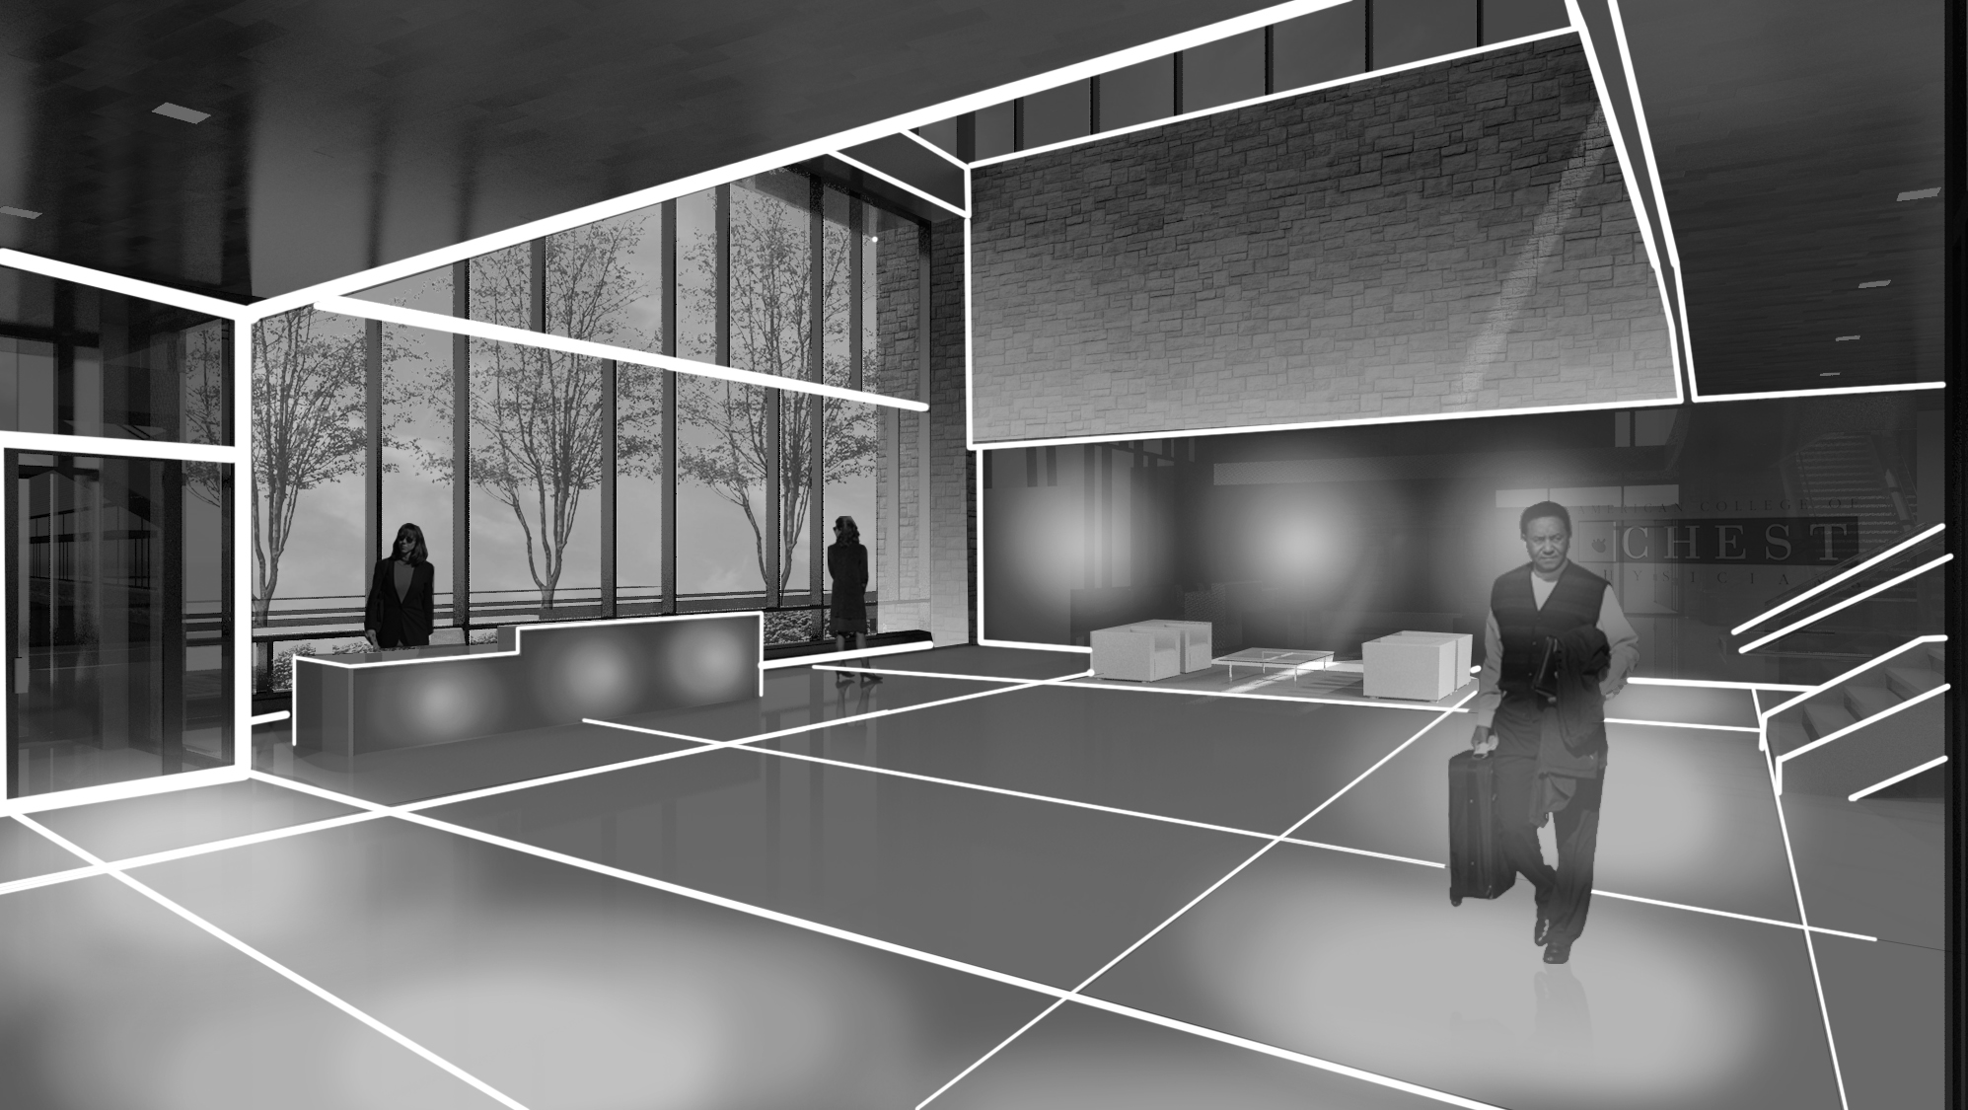
Main Lobby > Schematic Design 1

Slide 40
Main Lobby > Schematic Design 1
Light Spots create points of discontinuity in the planes of the space.
The pattern of spots continues from floor to wall and connects horizontal and parallel surfaces.
Transitional brightness at entrances will aid adaptation in daylight scenarios.
Light spots aid in way finding and highlight important locations in the Lobby

Slide 41
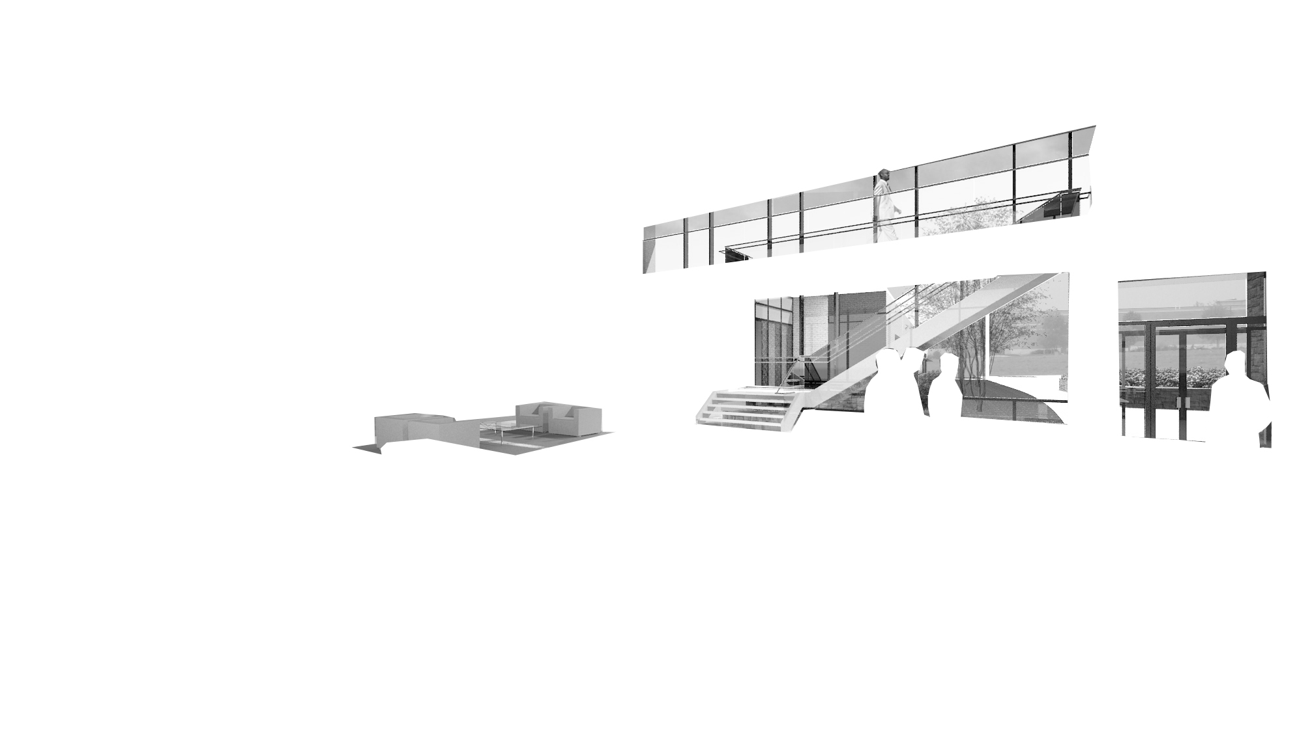
Main Lobby > Schematic Design 2

Slide 42
Main Lobby > Schematic Design 2

Slide 43
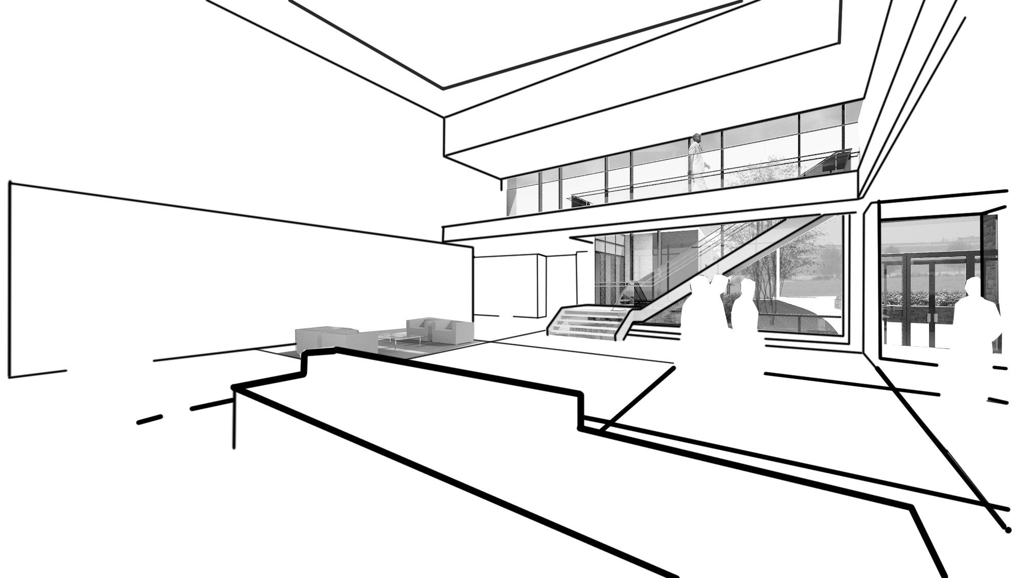
Main Lobby > Schematic Design 2

Slide 44
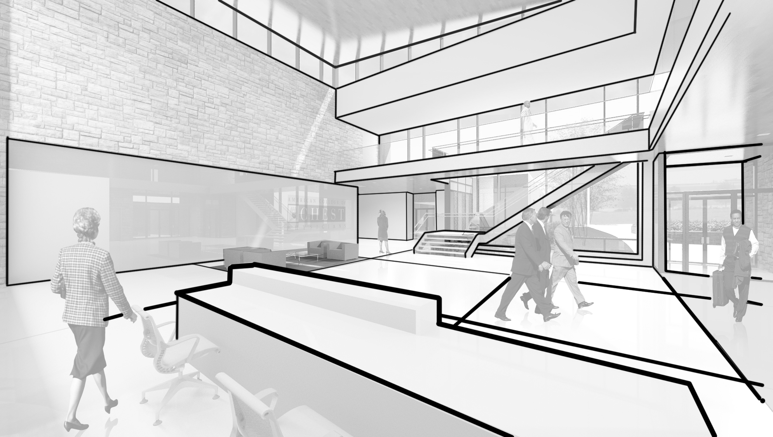
Main Lobby > Schematic Design 2

Slide 45
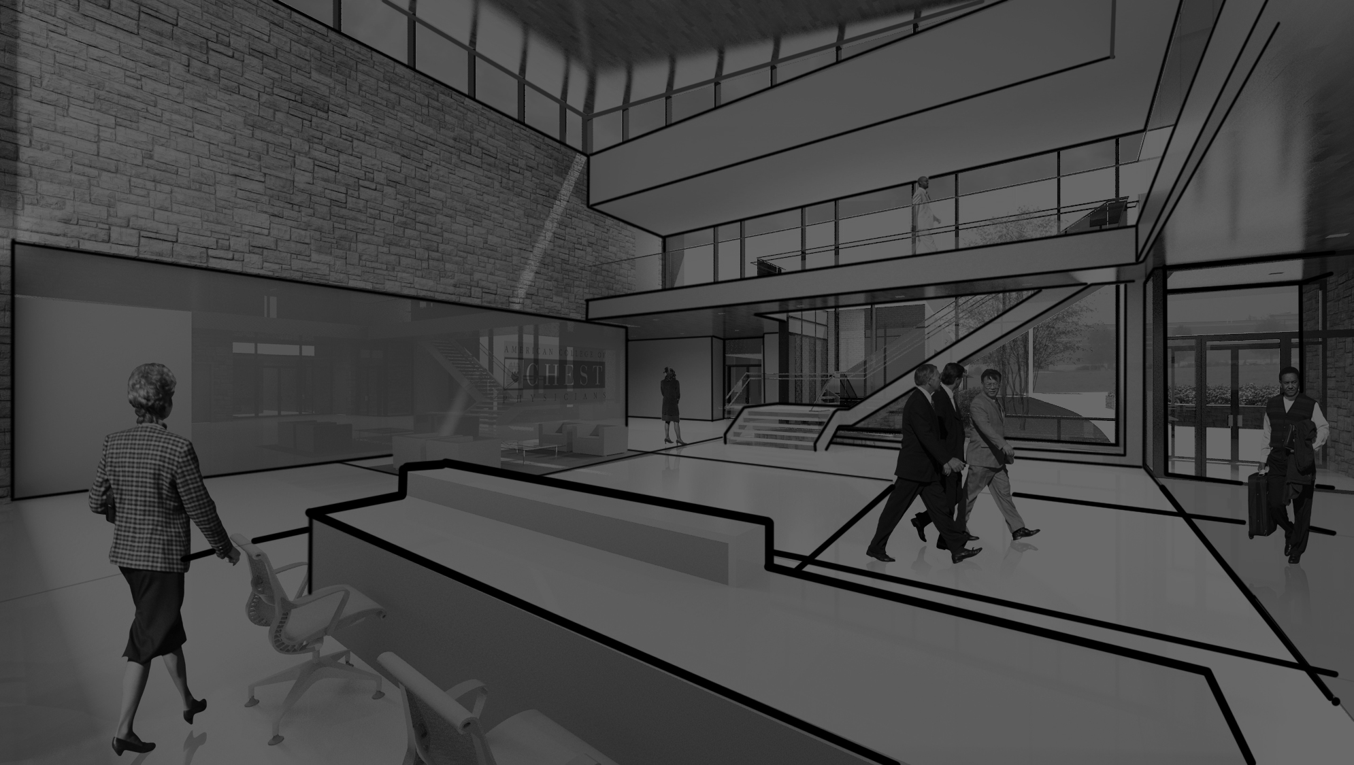
Main Lobby > Schematic Design 2

Slide 46
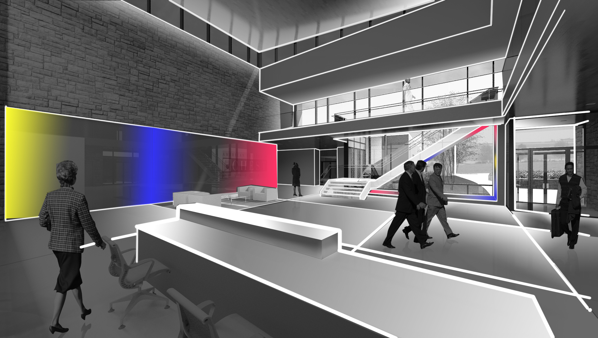
Main Lobby > Schematic Design 2

Slide 47
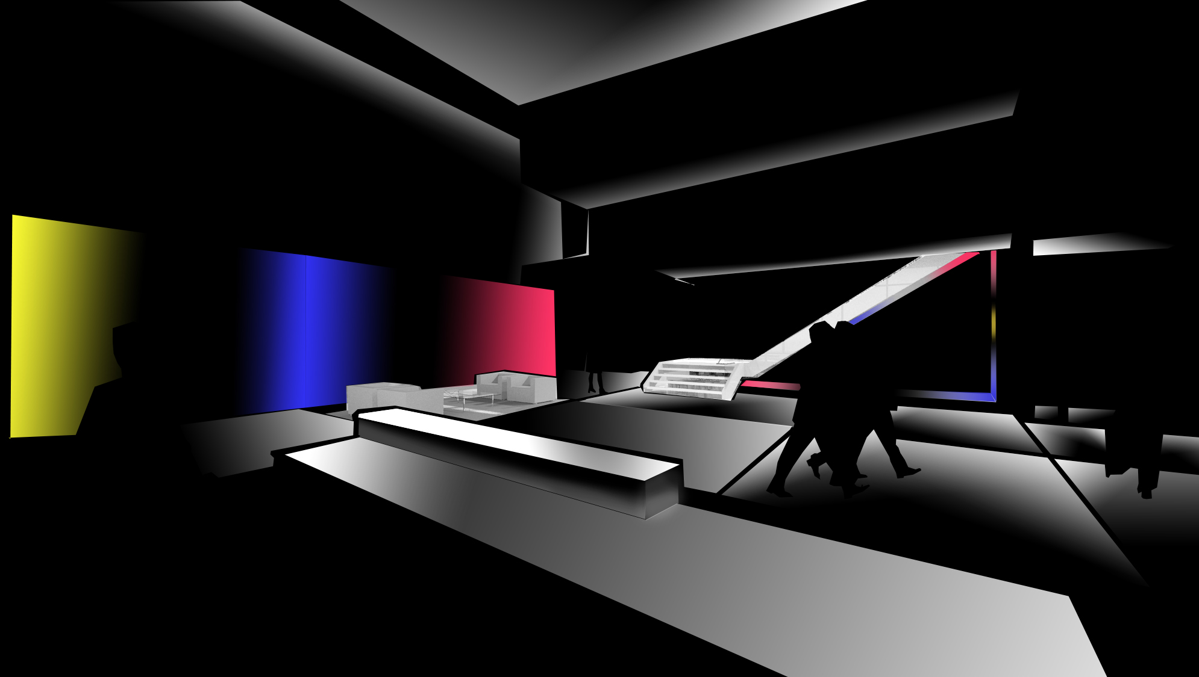
Main Lobby > Schematic Design 2

Slide 48
Main Lobby > Schematic Design 2

Slide 49
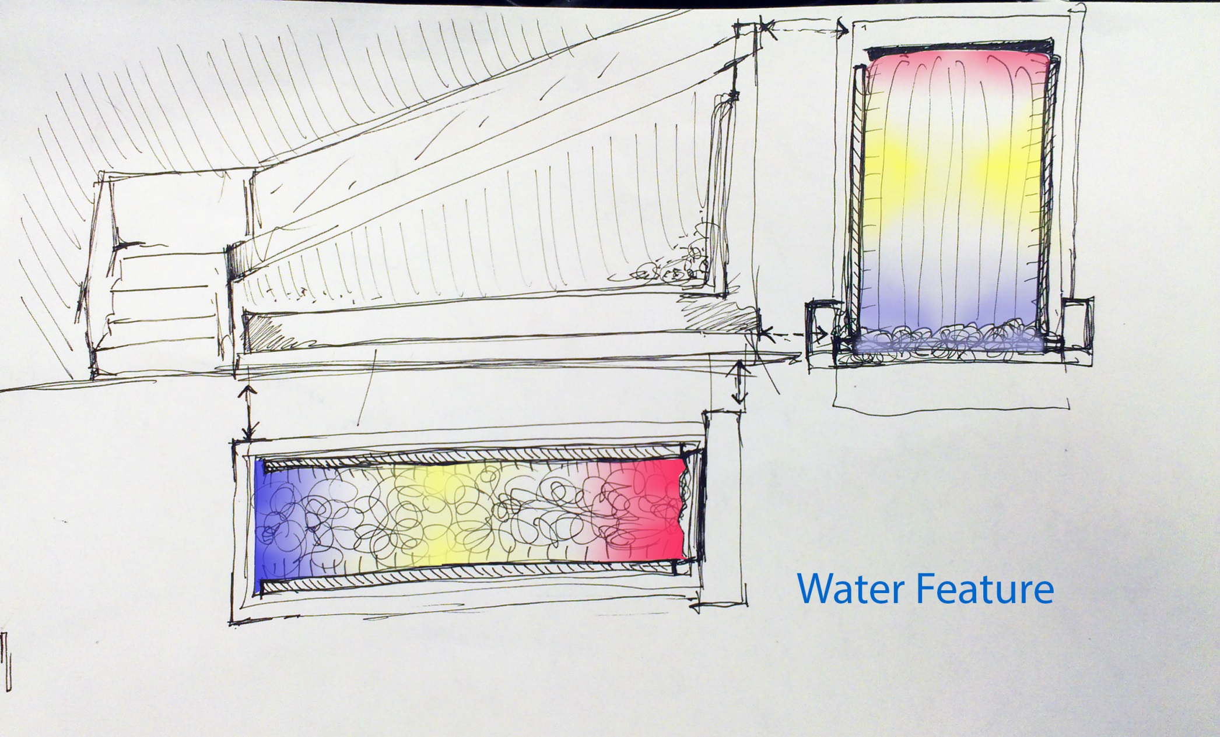
Main Lobby > Schematic Design 2
Linear LED rgb fixture

Slide 50
Main Lobby > Schematic Design 2
Why Color?
Colored ambient lighting creates unfamiliar atmosphere
Colored wall bright enough to illuminate faces and features of people in waiting area.
Color will render faces and features in new ways and will be ever changing.
Water feature lighting will reinforce color as a theme in the space
Lobby desk will also highlight color on the front fascia.

Slide 51
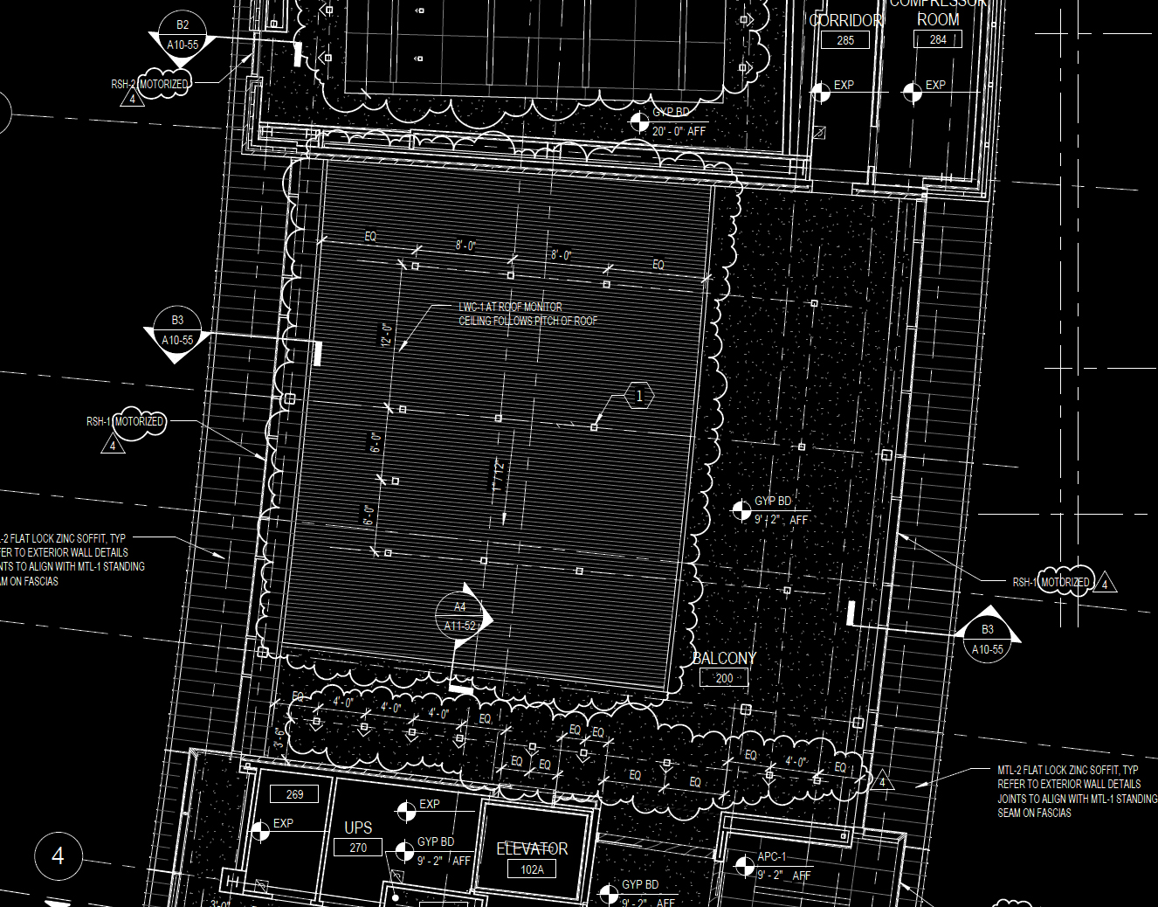
Main Lobby > Schematic Design 3

Slide 52
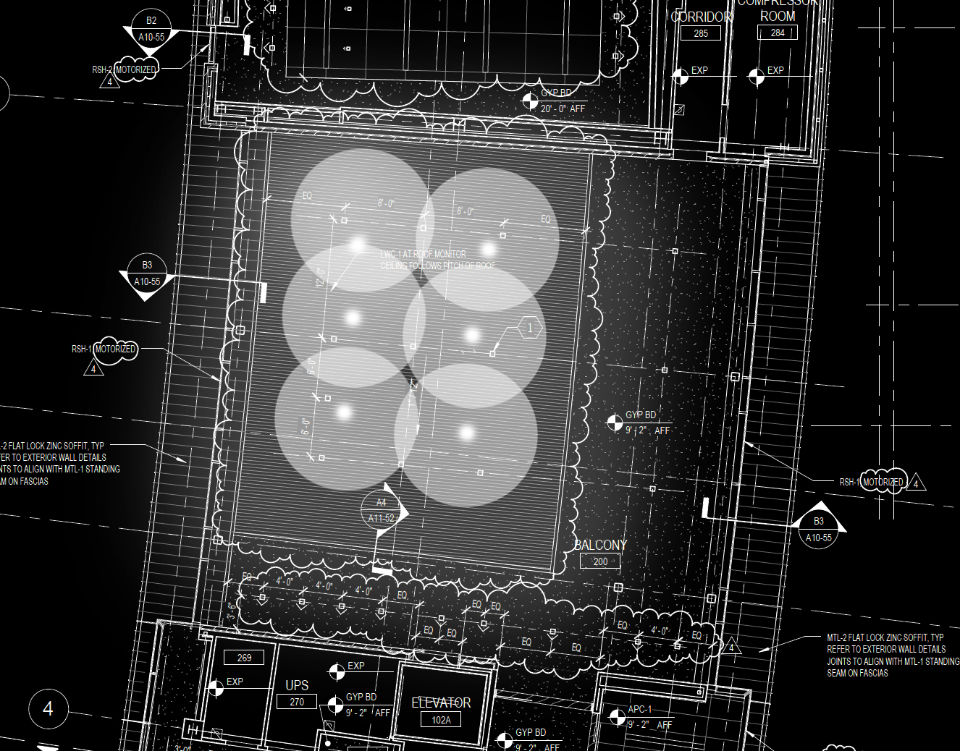
Main Lobby > Schematic Design 3

Slide 53
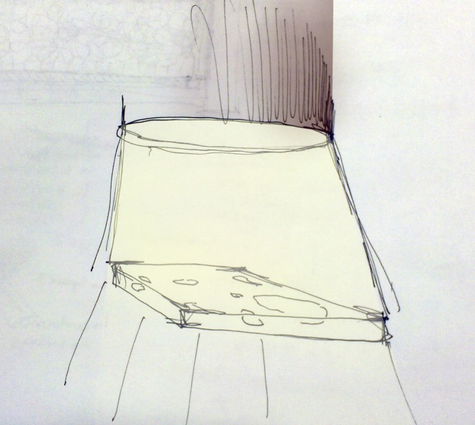
Main Lobby > Schematic Design 3

Slide 54
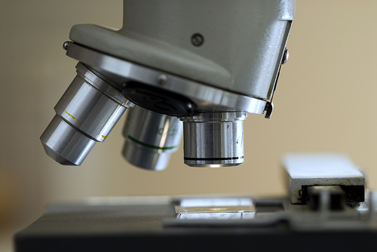
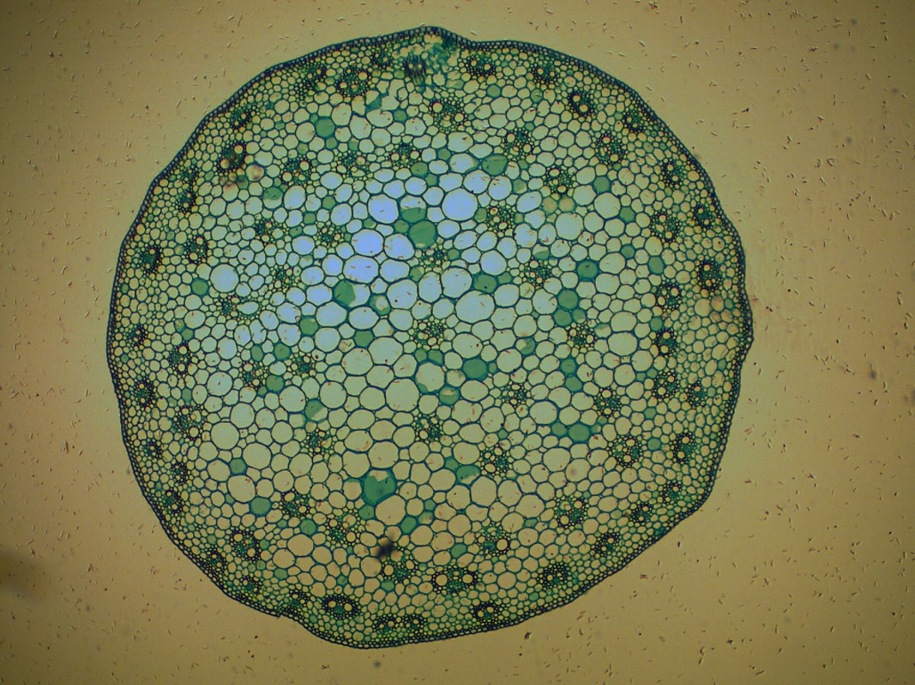
Main Lobby > Schematic Design 3
Microscope slide creates intricate organic patterns
Similar system would project biological pattern into space
Pattern will cover parts of the ground and some walls

Slide 55
Facade> Design Criteria + Considerations
Due to the semi-commercial residential nature of the surrounding areas I believe the college should be categorized as LZ2, medium activity.
SETTING | Illuminance vert. | Uniformity
Lighter toned façade material | 20lux | 3:1
Darker toned façade materials | 40lux | 3:1
Determine lowest acceptable light level
Control light levels to operate between dusk and curfew hours
Select luminaires for specific optical control to reduce glare

Slide 56
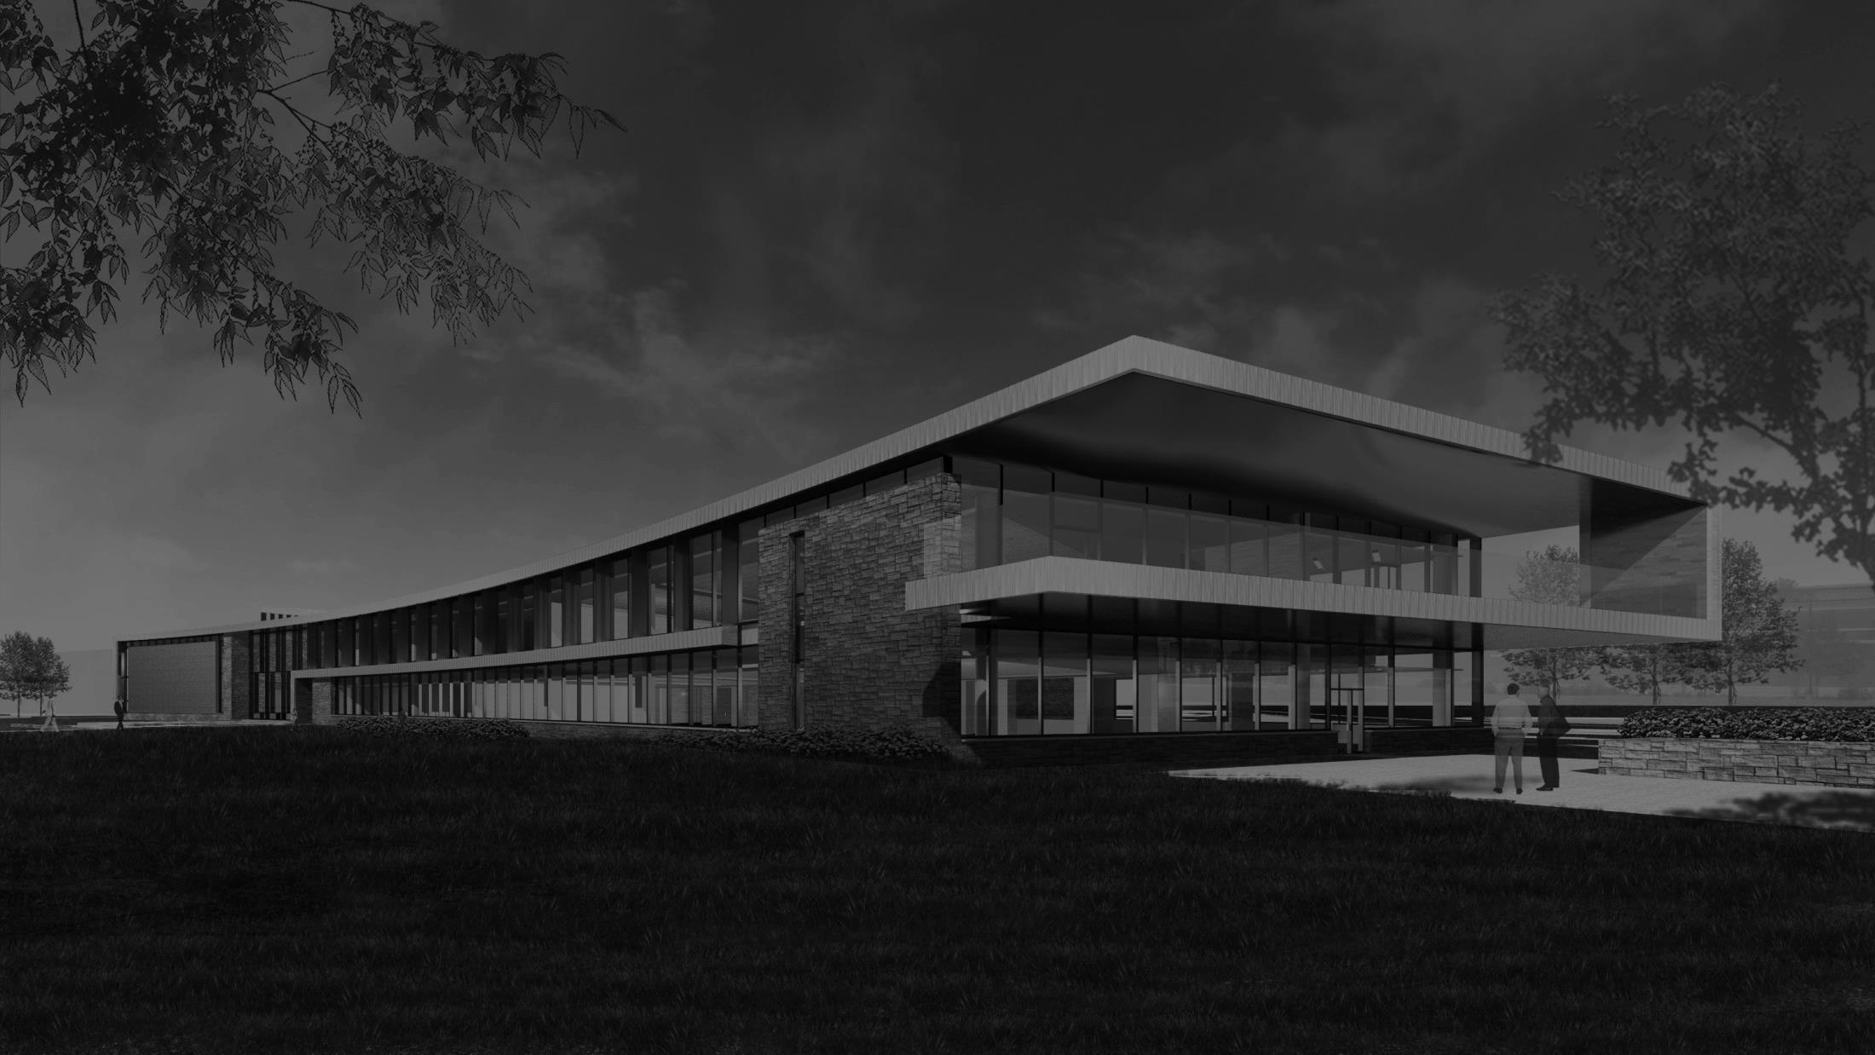
Facade> Schematic Design

Slide 57
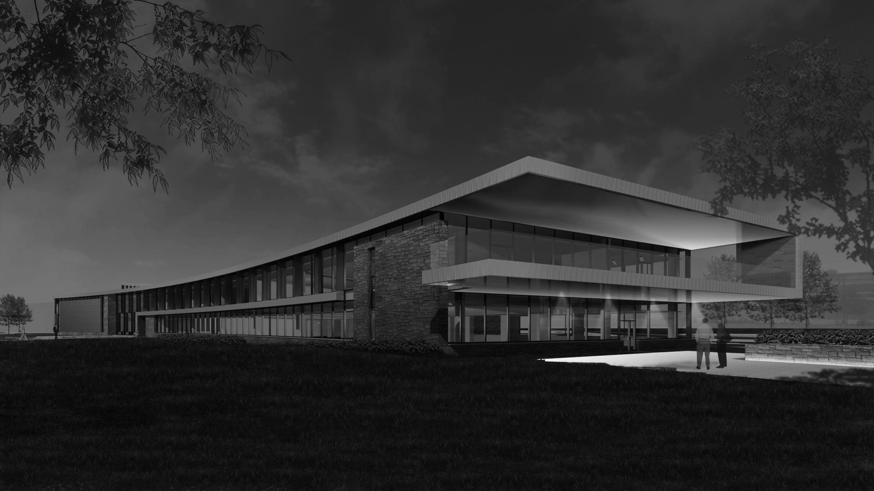
Facade> Schematic Design

Slide 58
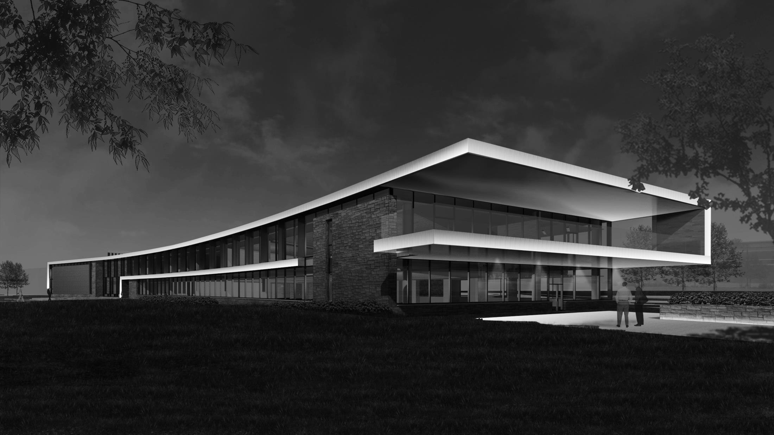
Facade> Schematic Design
Highlights continuous surface which exists in multiple planes

Slide 59
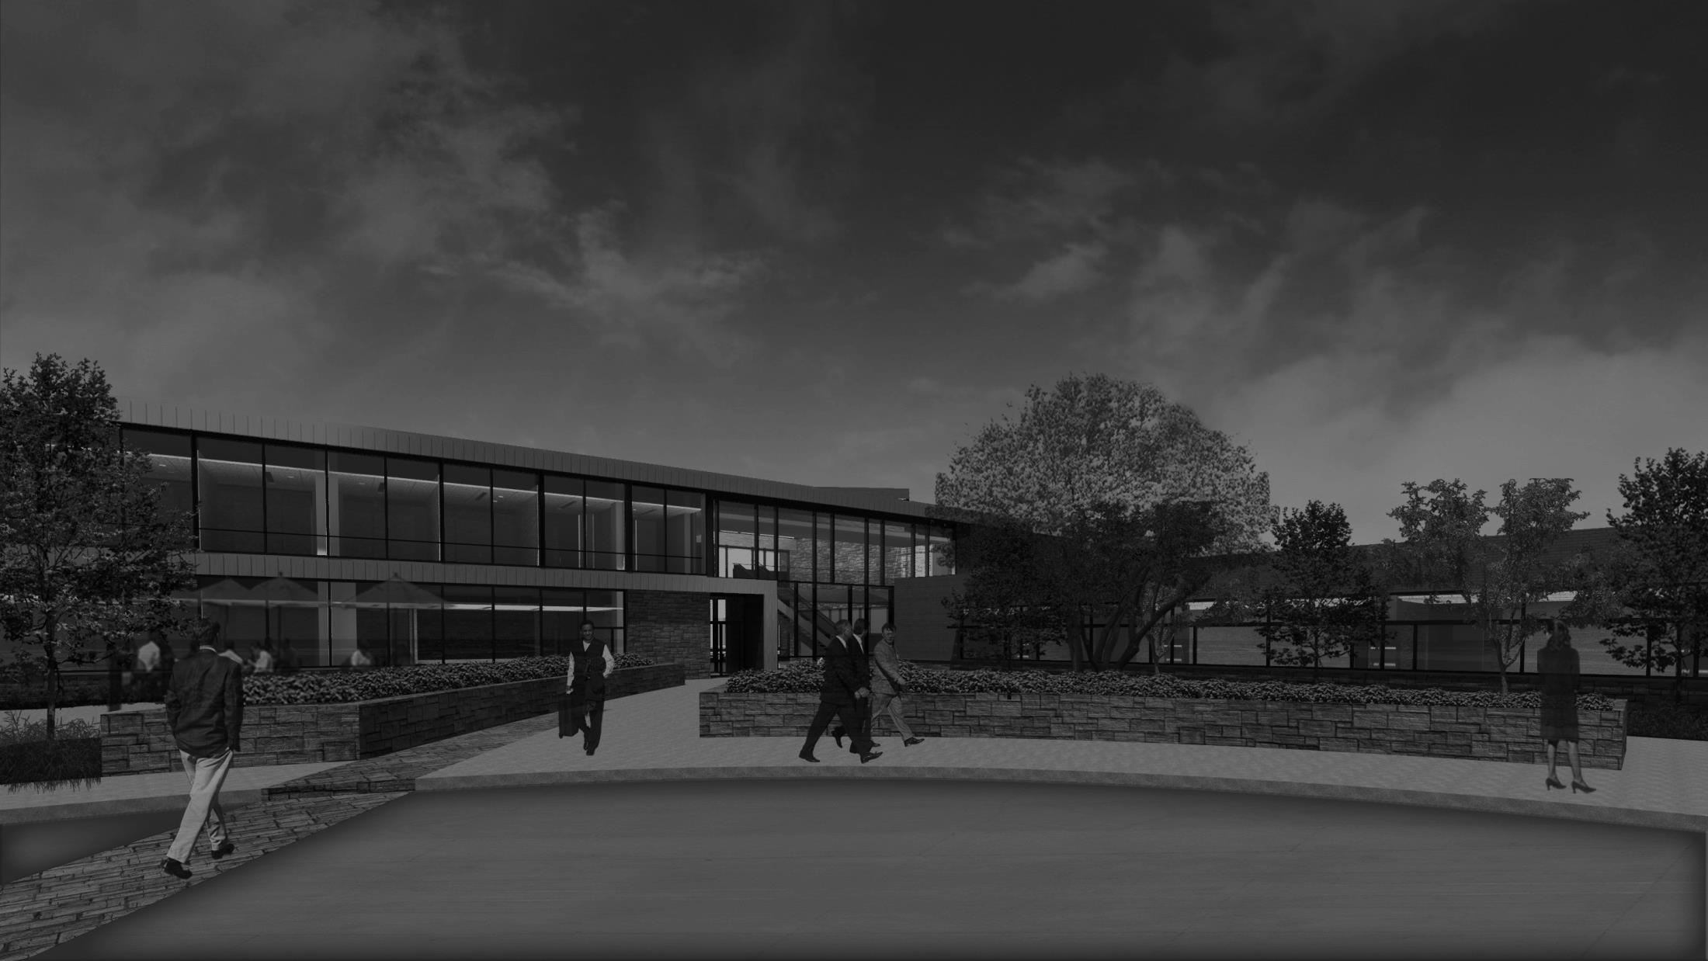
Facade> Schematic Design

Slide 60
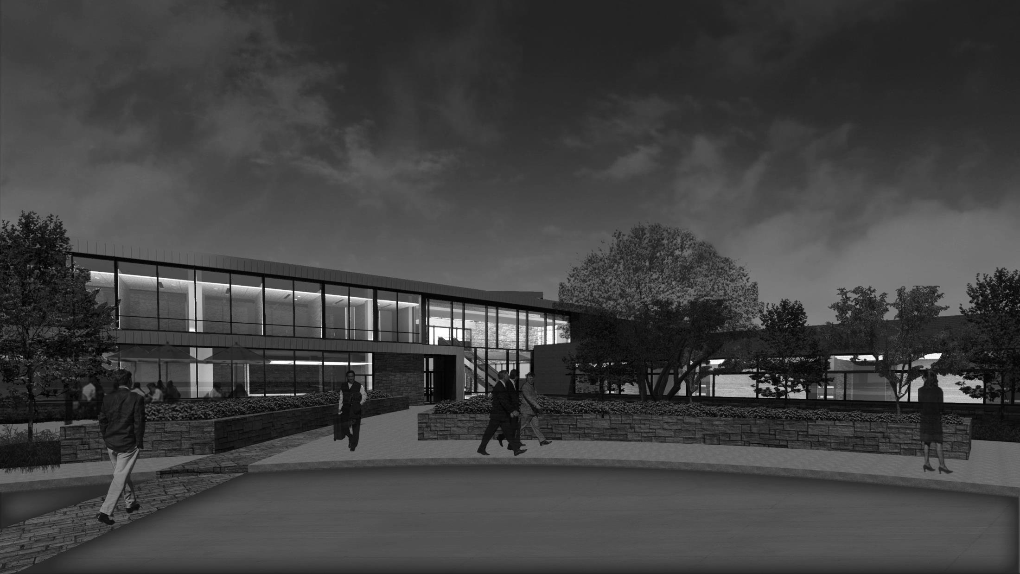
Facade> Schematic Design

Slide 61
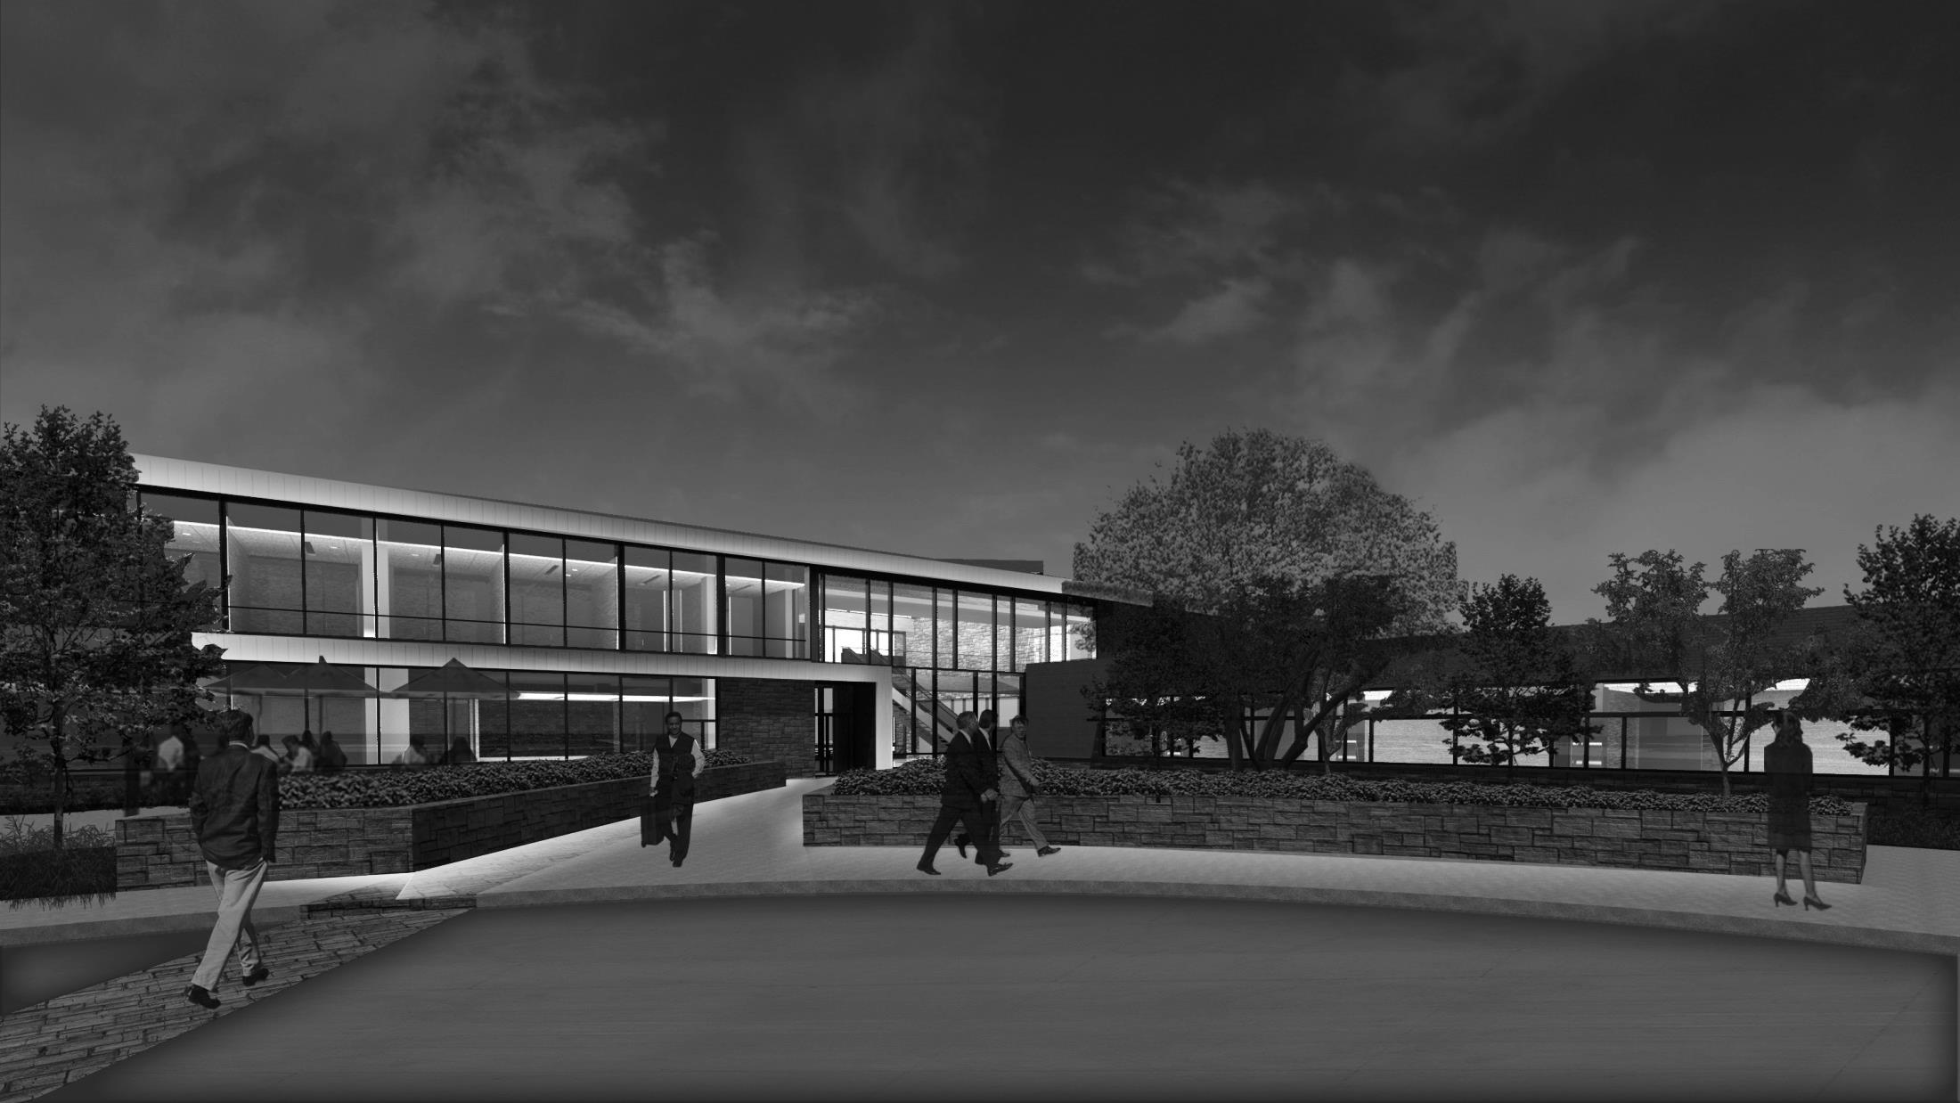
Facade> Schematic Design

Slide 62
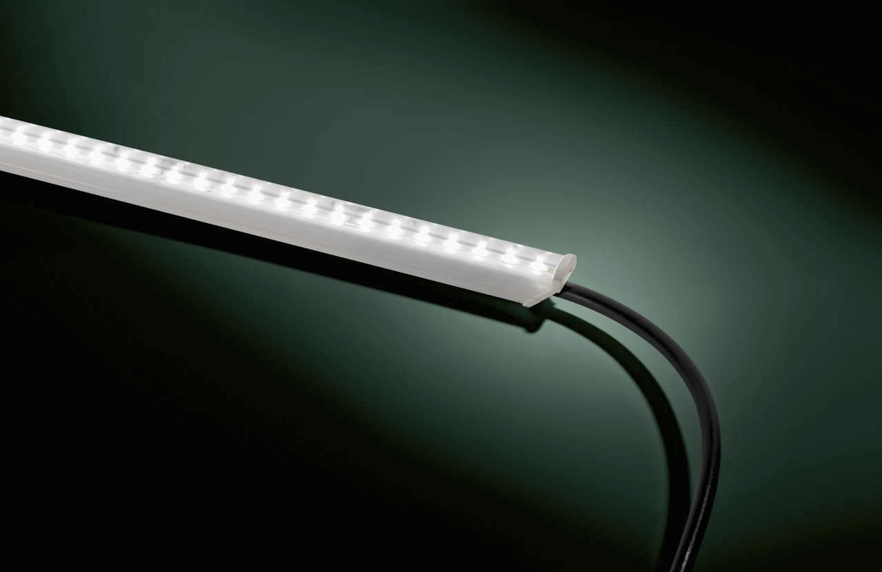
Facade> Schematic Design > Fixtures
Exterior Linear LED
Mounted to upper edge of surrounding facia

Slide 63
THE END

